Slide 1
Digi Tech India
A Complete Online Solution to Manage All School Needs

Slide 2
A Smartest Way to Get Closer
PARENT, TEACHER & STUDENT

Slide 3
Type “Digitech India” in Google Play Store & Apple App Store
To Download the app, click on Install

Slide 4
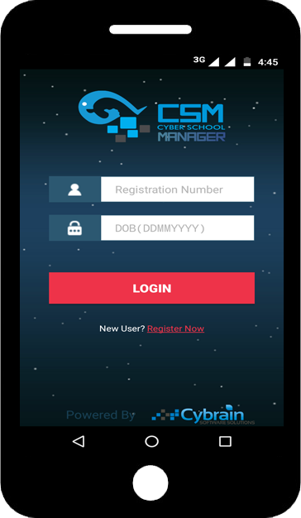
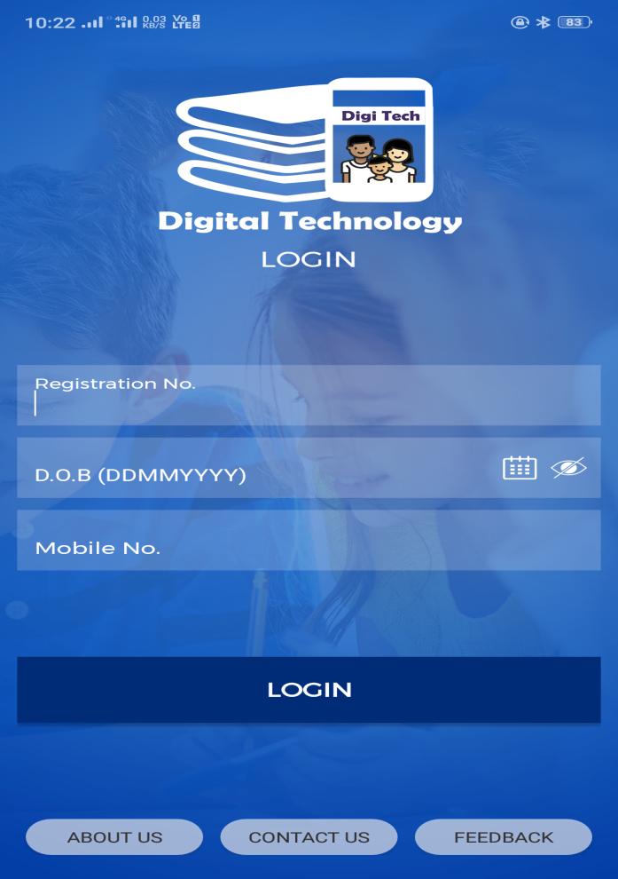
How to Register
After successful Installation Users need to register. For new registration click on Register Now link.

Slide 5
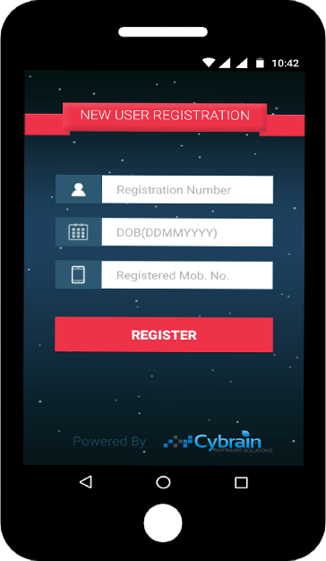
New User Registration
Enter Student’s Registration Number (Provided by School, unique id of student)
Enter Student’s Date of Birth (in DDMMYYYY Format)
Enter Parent’s Mobile Number registered in school records.
Click on Register Button

Slide 6
Congratulations!!!
Your mobile number is successfully verified. Now Digitech Mobile App is ready to use.
Now parent can also login in multiple mobiles using Student’s Registration Number as User id and Date of Birth as login password.
Click on Login Button

Slide 7
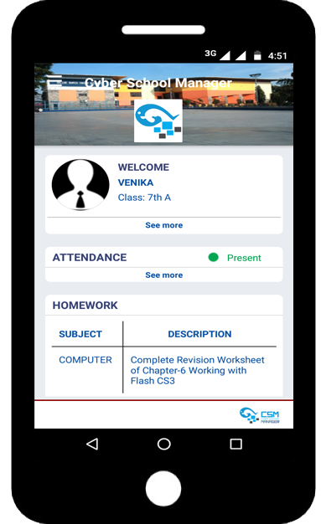
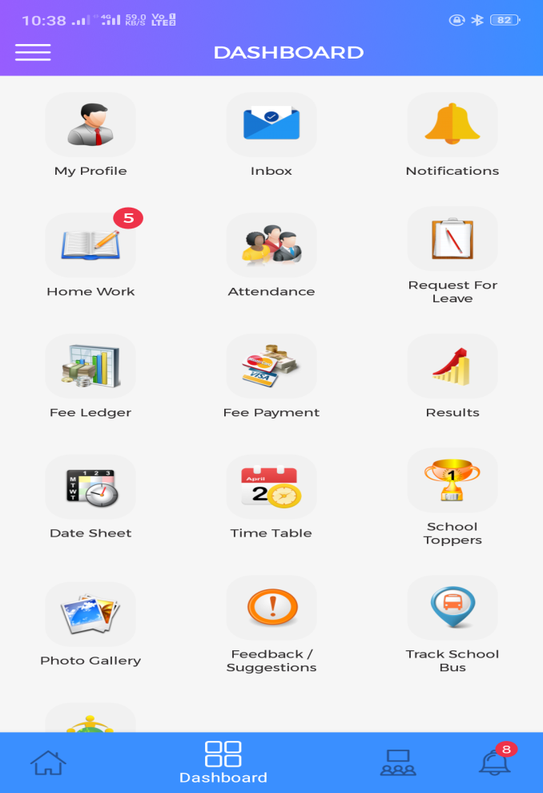
Welcome on the Dashboard.
After Successful Login on home screen user can see Student’s Profile, Attendance Status, Latest Homework, Messages, Notifications and School Gallery etc.

Slide 8
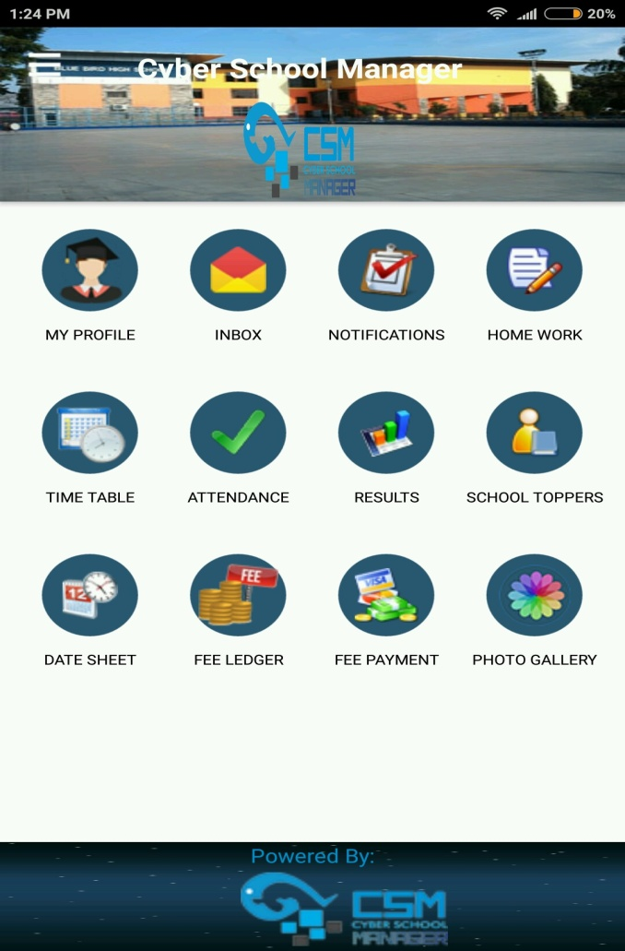
CSM Dashboard
On the Dashboard user can access all the Digi Tech features.
To see the student’s profile, tap on My Profile icon.

Slide 9
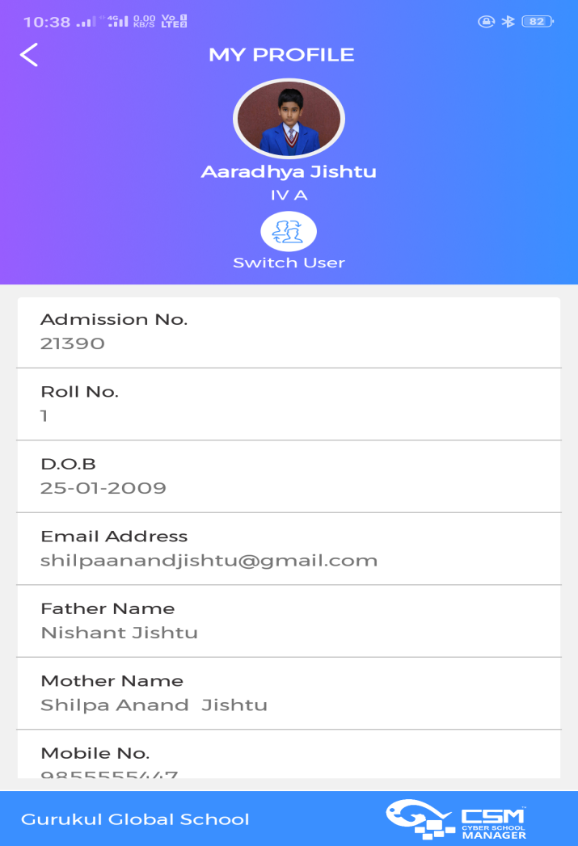
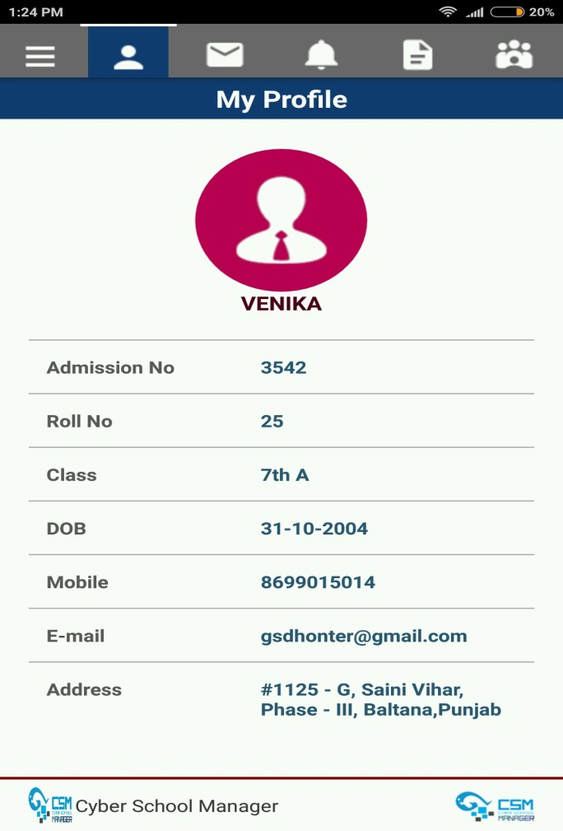
Student Profile
Here all basic information about the student can check like Admission Number, Roll Number, Class, Date of Birth, Parent’s Mobile Number, Email Id and Address etc.

Slide 10
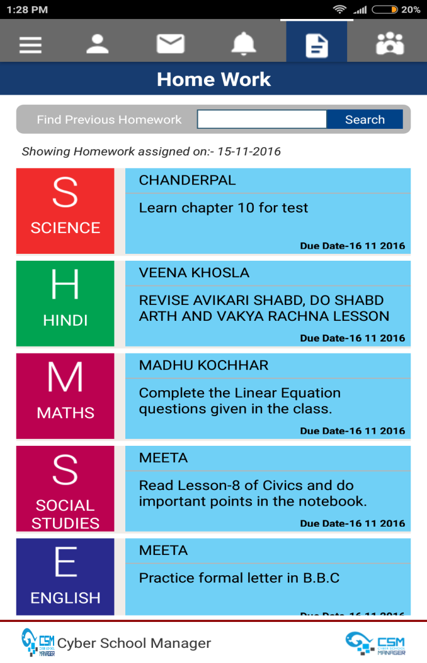
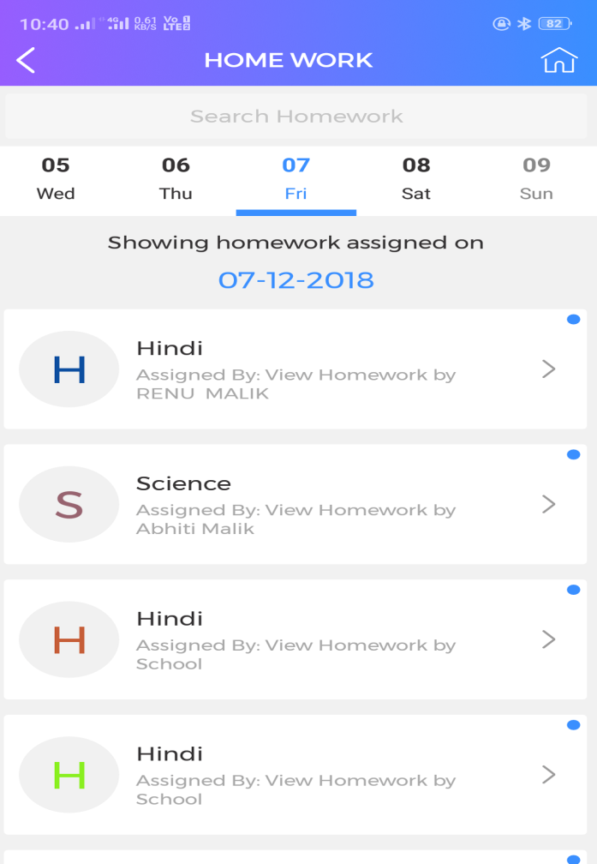
E-Home Work
No need to write the homework in diaries or notebooks. Just one click in a Digi Tech app and Students/Parents will get the full information.

Slide 11
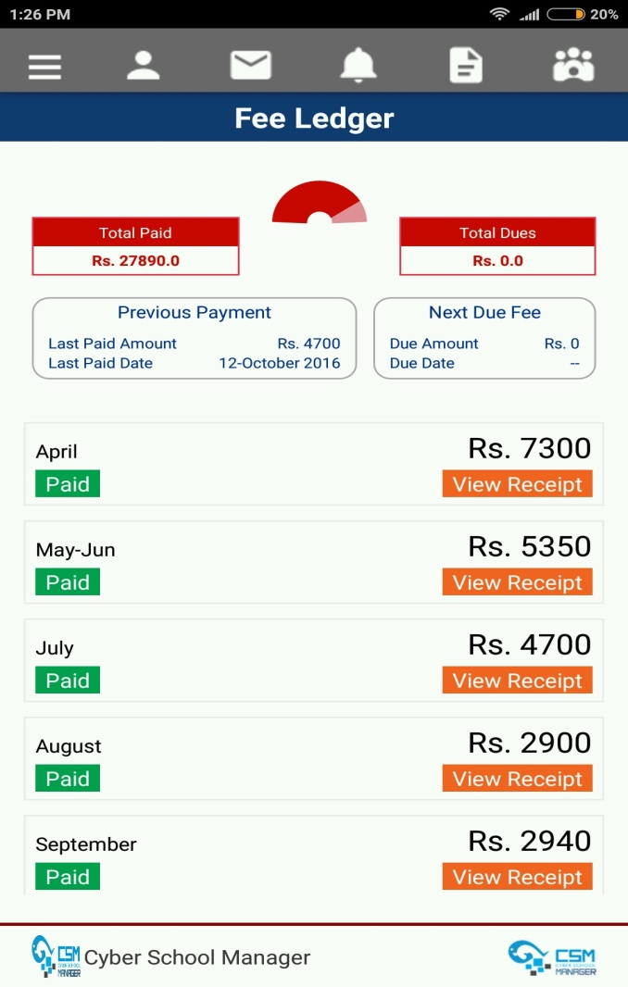
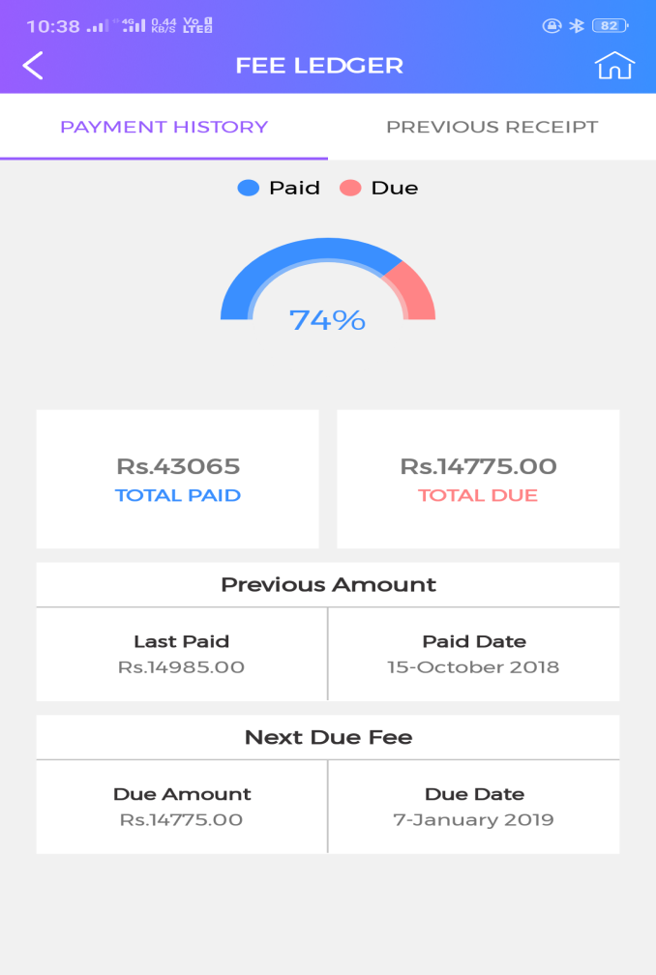
Fee Ledger
Now Parent have complete details of fee like paid fee, last paid date, Next due amount and due date. They will get instant acknowledgement from Digi Tech App as fee Receipt upon successful payment.

Slide 12
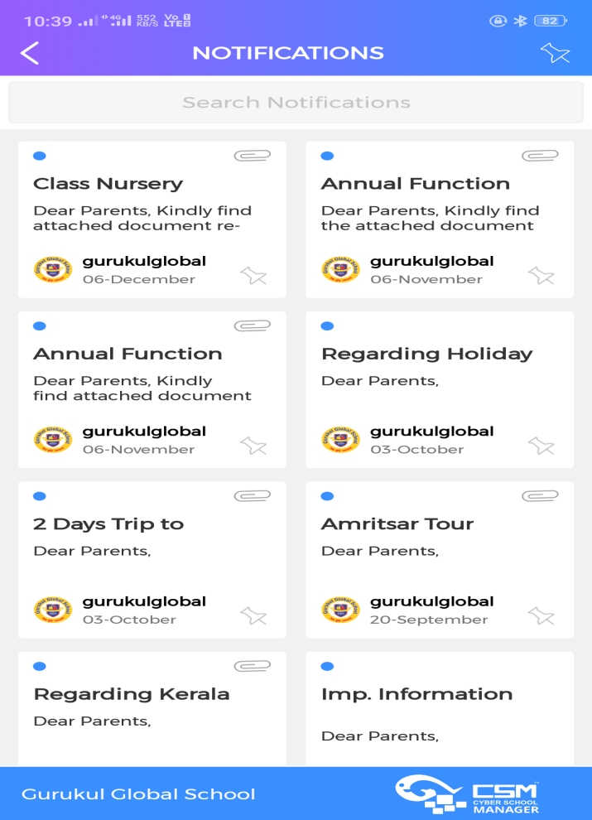
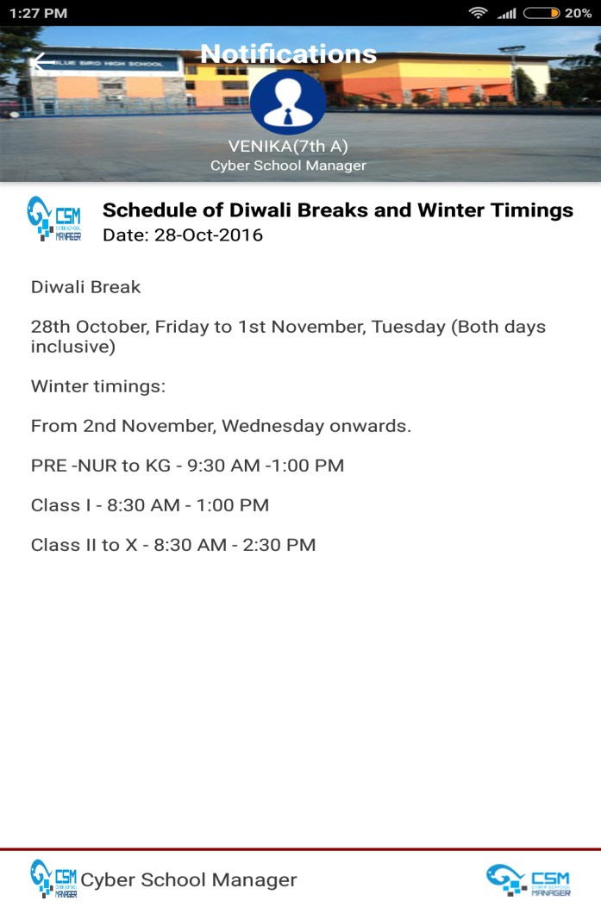
Notifications
School’s Notifications are very important for parent. Now parent have instant information regarding any events, activities and all kind of communication by school.

Slide 13
For more details Visit: www. digitechindia.co.in Call us :+91-9814899371, 7009955967 Email us : info@ digitechindia.co.in

Slide 14
Thank you

